Slide 1
Electric-field Mapped Averaging
For Dielectric Constant
Weisong Lin

Slide 2

Introduction
What is dielectric constant?
Definition from Wikipedia: The relative permittivity of a material is its dielectric permittivity expressed as a ratio relative to the permittivity of vacuum.
How to measure it?
+Q
+
+
+
+
+
+
+
+
+
+
+
+
+
+
d
-
-
-
-
-
-
-
-
-
-
-
-
-
-
-Q
Dielectric

Slide 3
Introduction
What is dielectric constant?
Definition from Wikipedia: The relative permittivity of a material is its dielectric permittivity expressed as a ratio relative to the permittivity of vacuum.
How to measure it?
+Q
+
+
+
+
+
+
+
+
+
+
+
+
+
+
-
-
-
-
-
-
-
+
+
+
+
+
+
+
-
-
-
-
-
-
-
-
-
-
-
-
-
-
-Q
Dielectric

Slide 4

Formalism
Free-energy perturbation
Find free energy difference by averaging over microstates sampled from ensemble
FEP:
0
1
0
1
Targeted FEP:*
0
0`
1
*Jarzynski 2002

Slide 5
Formalism
Mapped averaging
Mapped average improves the Target FEP by coupling to displacement of coordinates.
FEP:
Mapped average:
Introduce mapping :

Slide 6
Formalism
Application to dielectric constant
0
Dielectric constant
0
Mapped averaging
As a prototype
Notes:
This is evaluated in the limit E → 0. Assuming the system has
381 no permanent dipole moment (⟨M⟩ = 0) and is isotropic and
382 homogeneous, then only the diagonal elements of the
383 fluctuation tensor are nonzero. Hence, we may take the
384 derivative of interest as the trace of the tensor or, in 3D,
A mapped average can be formed for each of these terms and
387 summed to yield the required derivative. As they differ only in
388 the coordinate direction, we use −β ⟨Mz ⟩ = E E
389 prototype for all three.

Slide 7
Formalism
Application to dielectric constant
Or
Mapping:

Slide 8
Formalism
Necessary derivatives *
State variables:
*Moustafa, S. G.; Schultz, A. J.; Kofke, D. 2015

Slide 9
Formalism
Jacobian *
Mapping satisfies
With
*Moustafa, S. G.; Schultz, A. J.; Kofke, D. 2015

Slide 10
Formalism
Final expression with combination of three directions:

Slide 11
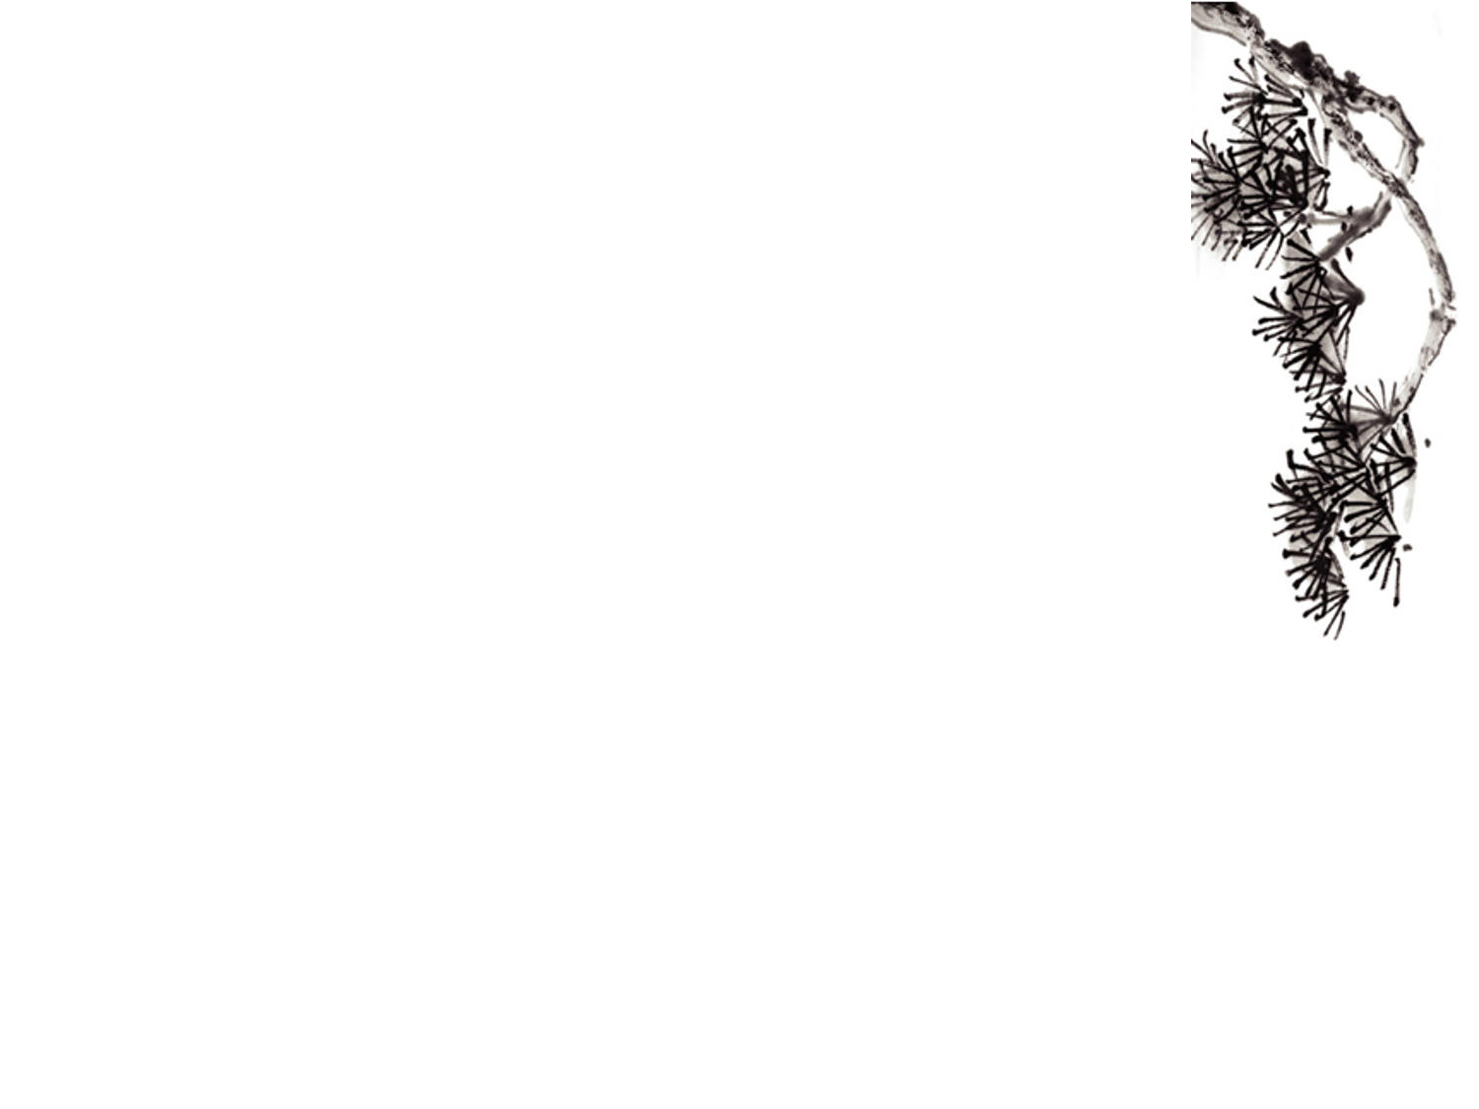
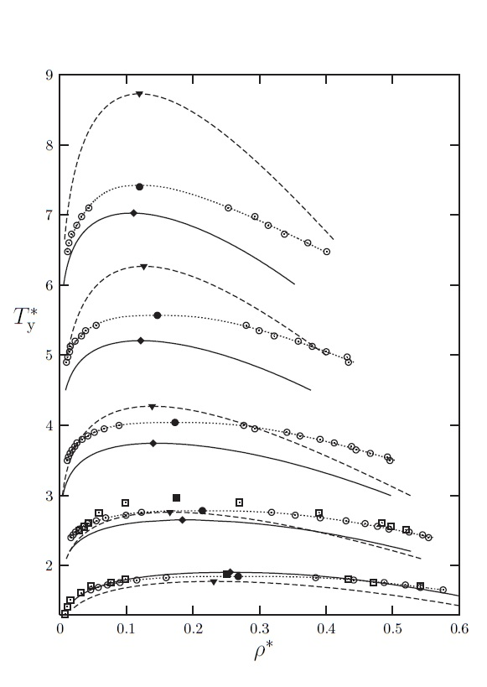
Results
StockMeyer Fluid phase diagram*
*Kalyuzhnyi, Protsykevytch, Ganzenmüller, Camp 2008
Notes:
Liquid-vapour coexistence in the dipolar Yukawa hard-sphere fluid
Yu. V. Kalyuzhnyi1, I. A. Protsykevytch1, G. Ganzenmüller2 and P. J. Camp2
15 August 2008
where t is the amount of CPU time required to obtain the result
y with uncertainty σ.

Slide 12
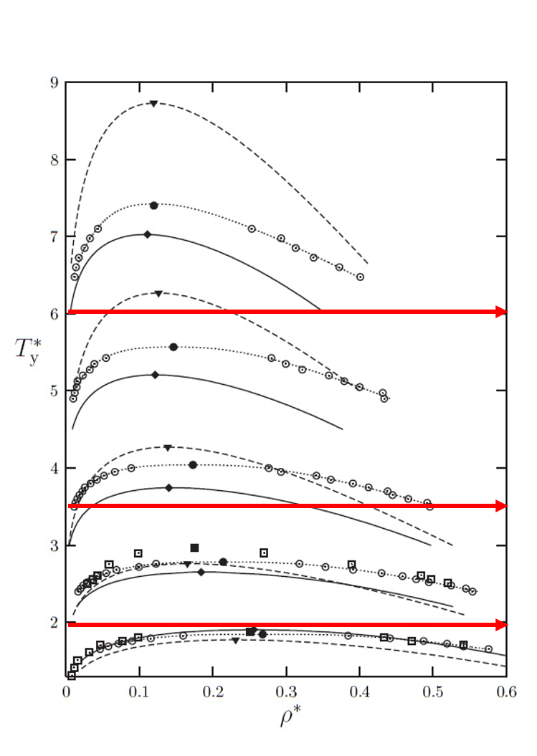
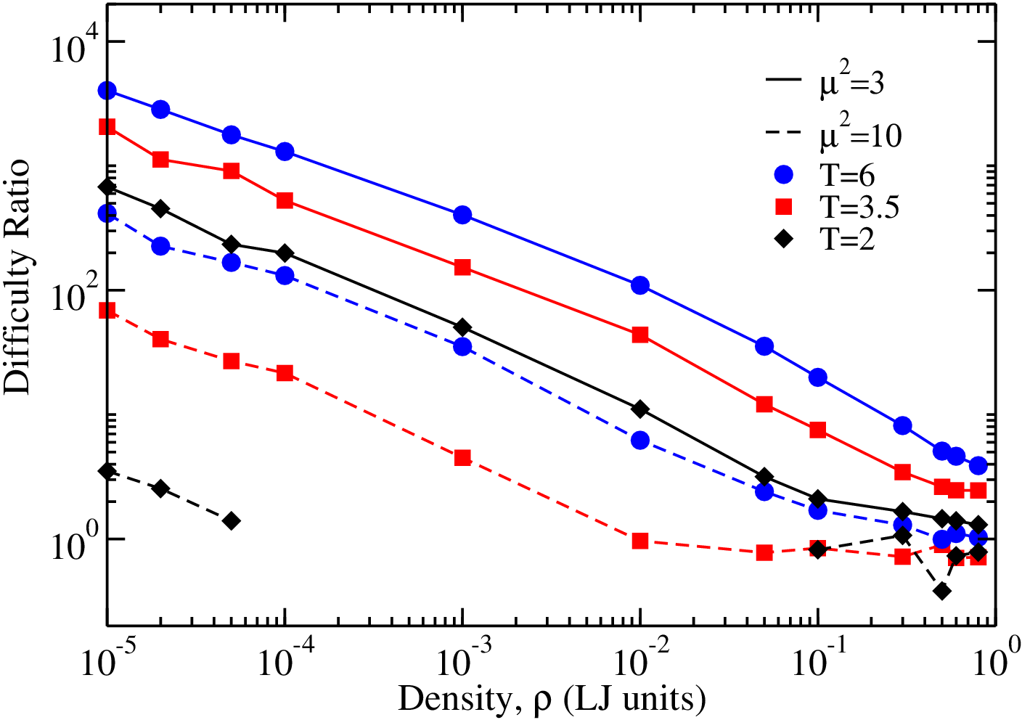
Results
Difficulty Ratio of Stockmayer Fluid*
*Andrew, Sabry, Weisong, Steven, David 2016
Notes:
where we plot the difficulty ratio for conventional versus mapped averaging, as a function of density for three temperatures and two values of the dipole strength D (note that \mu^2 for water). The performance improvement with mapped averaging is greatest at conditions where the noninteracting-dipole approximation to p is most appropriate: higher temperature, lower density, and smaller dipole strengths; the behavior correlates well with the dipolar coupling strength, 2=T .In the most favorable case presented (at very low density), the reduction of CPU is approaching a factor of 10^8; the least-favorable case corresponds to a liquid-like density and temperature, where the advantage of mapped averaging (in this particular formulation, based on non-interacting dipoles) is negligible.

Slide 13
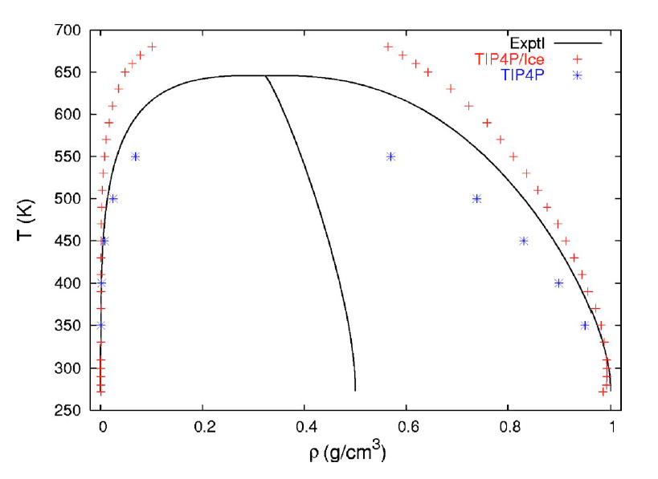
Results
Water phase diagram*
*Vegaa and J. L. F. Abascal 2006
Notes:
This picture form c Vapor-liquid equilibria from the triple point up to the critical point
for the new generation of TIP4P-like models: TIP4P/Ew, TIP4P/2005,
and TIP4P/ice
C. Vegaa and J. L. F. Abascal THE JOURNAL OF CHEMICAL PHYSICS 125, 034503 2006

Slide 14
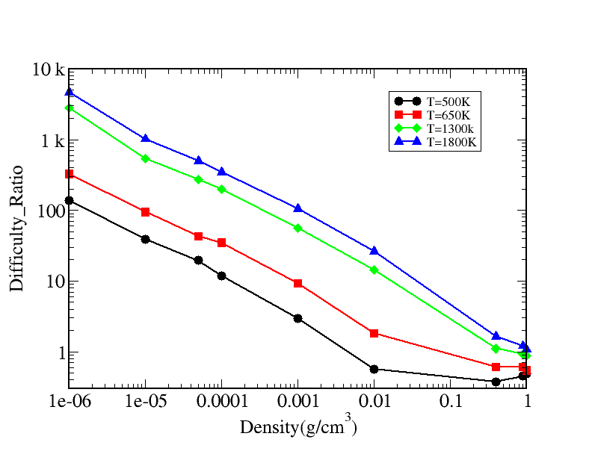
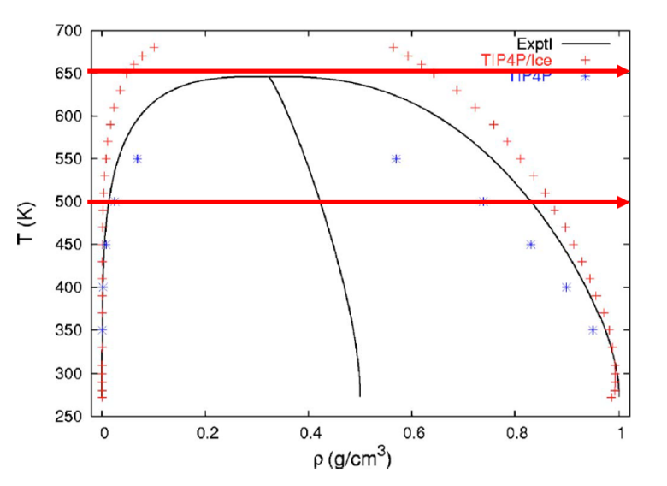
Result
Difficulty ratio along isothermal line*
*Writing not finished
Notes:
Results are presented in Fig. 3, where we plot the difficulty ratio for conventional versus mapped averaging, as a function of density for three temperatures and two values of the dipole strength D (note that \mu^2 for water). The performance improvement with mapped averaging is greatest at conditions where the noninteracting-dipole approximation to p is most appropriate: higher temperature, lower density, and smaller dipole strengths; the behavior correlates well with the dipolar coupling strength, 2=T .In the most favorable case presented (at very low density), the reduction of CPU is approaching a factor of 1108; the least-favorable case corresponds to a liquid-like density and temperature, where the advantage of mapped averaging (in this particular formulation, based on non-interacting dipoles) is negligible.
Density calculator: https://www.irc.wisc.edu/properties/
500k rho = 0.000440507743g/cm^3
650k rho = 0.000337989577g/cm^3
1300k rho = 0.0001681938654g/cm^3
1800k rho = 0.0001220606909g/cm^3

Slide 15
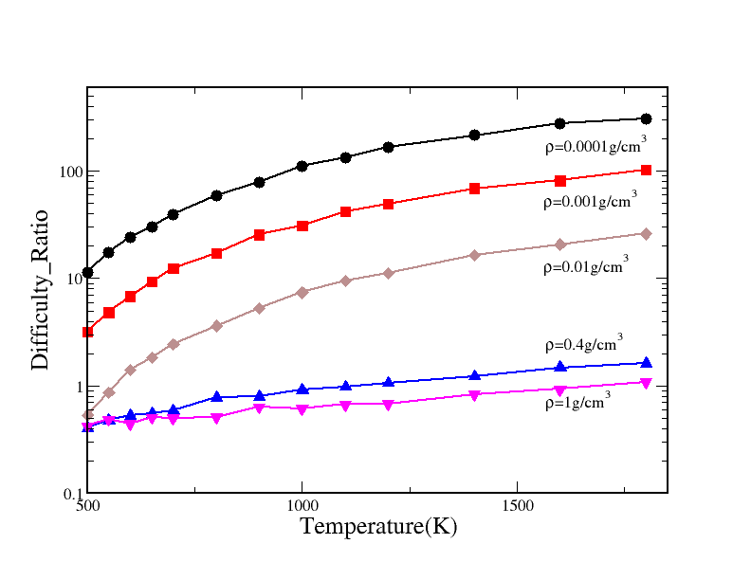
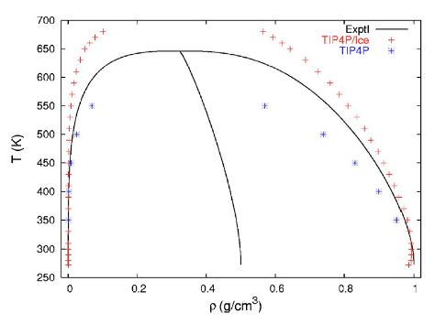
Results
Difficulty ratio along isochoric line
650

Slide 16
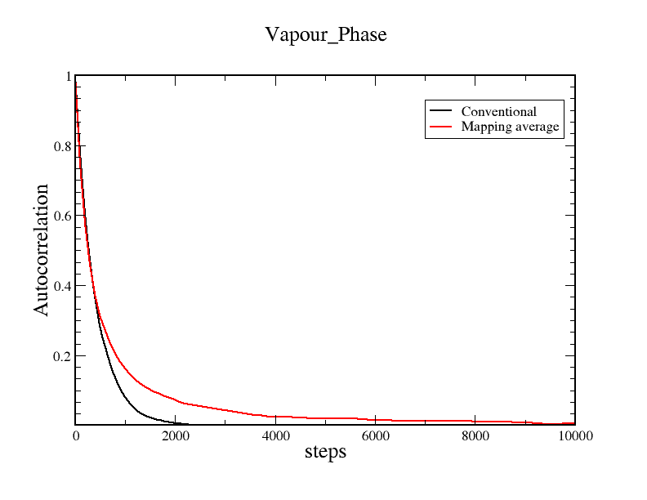
Correlation
Notes:
If random, such autocorrelations should be near zero for any and all time-lag separations.
Why need to be random
Most standard statistical tests depend on randomness. The validity of the test conclusions is directly linked to the validity of the randomness assumption.
Many commonly-used statistical formulae depend on the randomness assumption, the most common formula being the formula for determining the standard deviation of the sample mean:
sY¯=s/N−−√
where s is the standard deviation of the data. Although heavily used, the results from using this formula are of no value unless the randomness assumption holds.
For univariate data, the default model is
Y = constant + error
If the data are not random, this model is incorrect and invalid, and the estimates for the parameters (such as the constant) become nonsensical and invalid.
In short, if the analyst does not check for randomness, then the validity of many of the statistical conclusions becomes suspect. The autocorrelation plot is an excellent way of checking for such randomness.

Slide 17
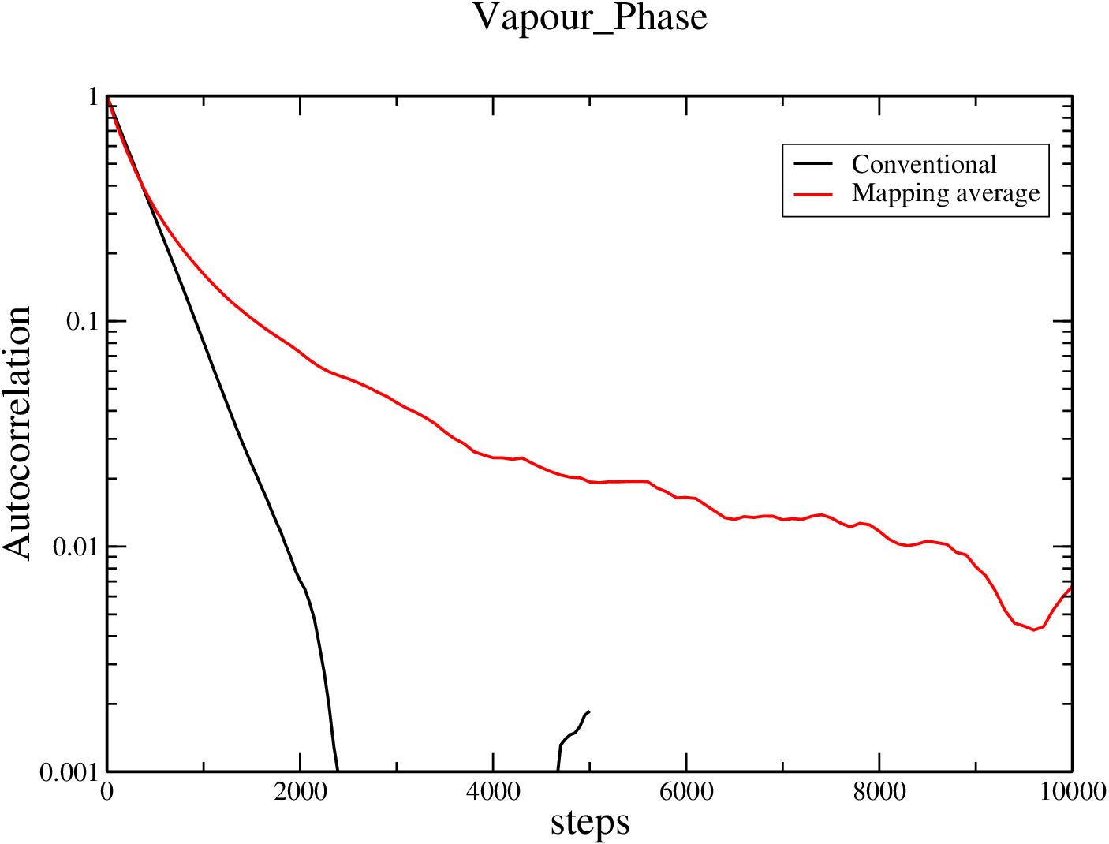
Correlation
Notes:
If random, such autocorrelations should be near zero for any and all time-lag separations.
Why need to be random
Most standard statistical tests depend on randomness. The validity of the test conclusions is directly linked to the validity of the randomness assumption.
Many commonly-used statistical formulae depend on the randomness assumption, the most common formula being the formula for determining the standard deviation of the sample mean:
sY¯=s/N−−√
where s is the standard deviation of the data. Although heavily used, the results from using this formula are of no value unless the randomness assumption holds.
For univariate data, the default model is
Y = constant + error
If the data are not random, this model is incorrect and invalid, and the estimates for the parameters (such as the constant) become nonsensical and invalid.
In short, if the analyst does not check for randomness, then the validity of many of the statistical conclusions becomes suspect. The autocorrelation plot is an excellent way of checking for such randomness.

Slide 18
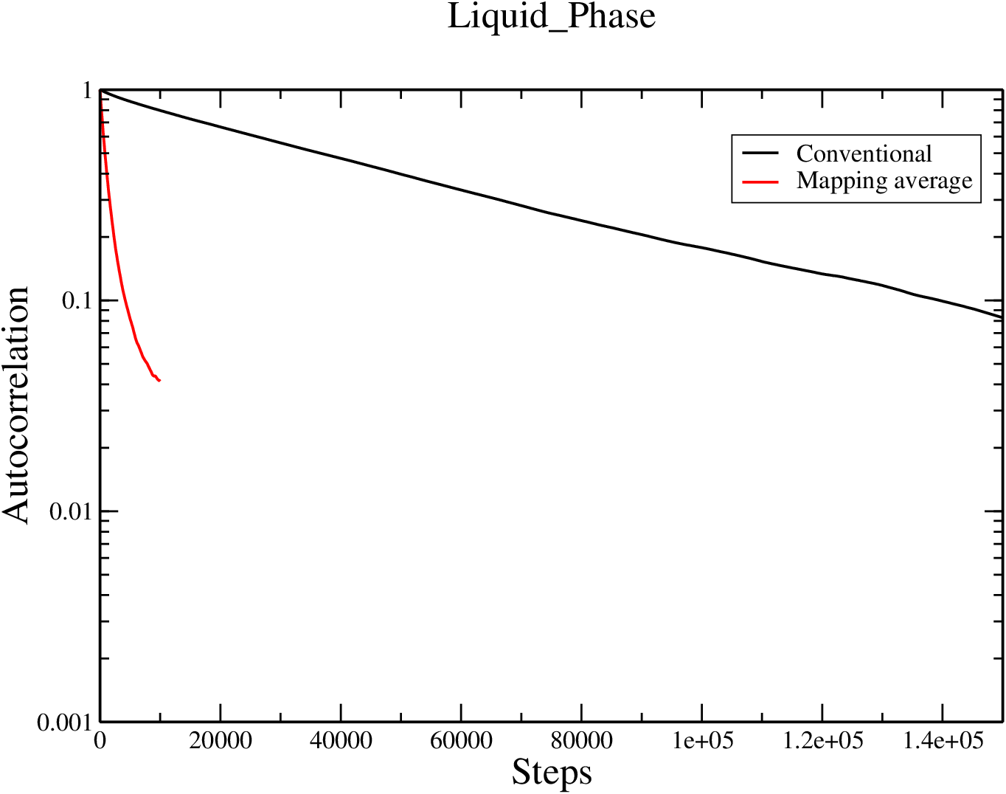
Correlation
Notes:
Liquid phase: Rho = 0.9
Gas phase: Rho = 0.001
T=650K

Slide 19
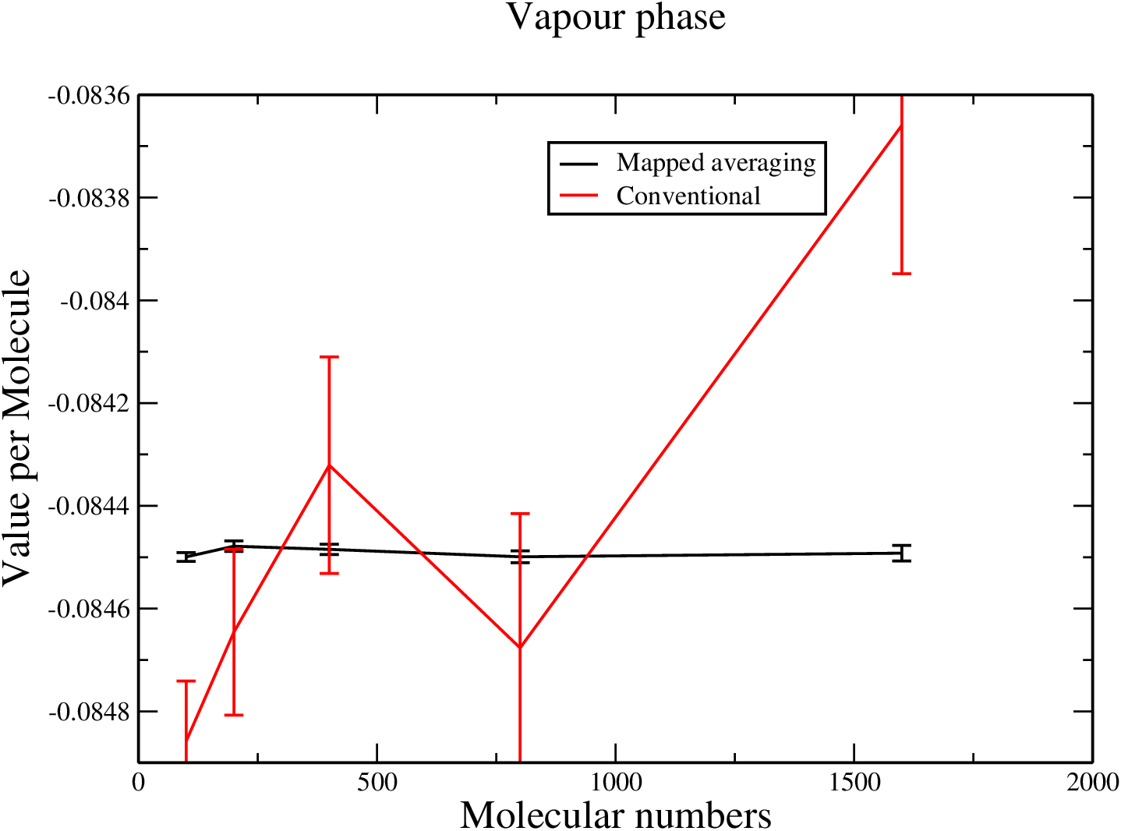
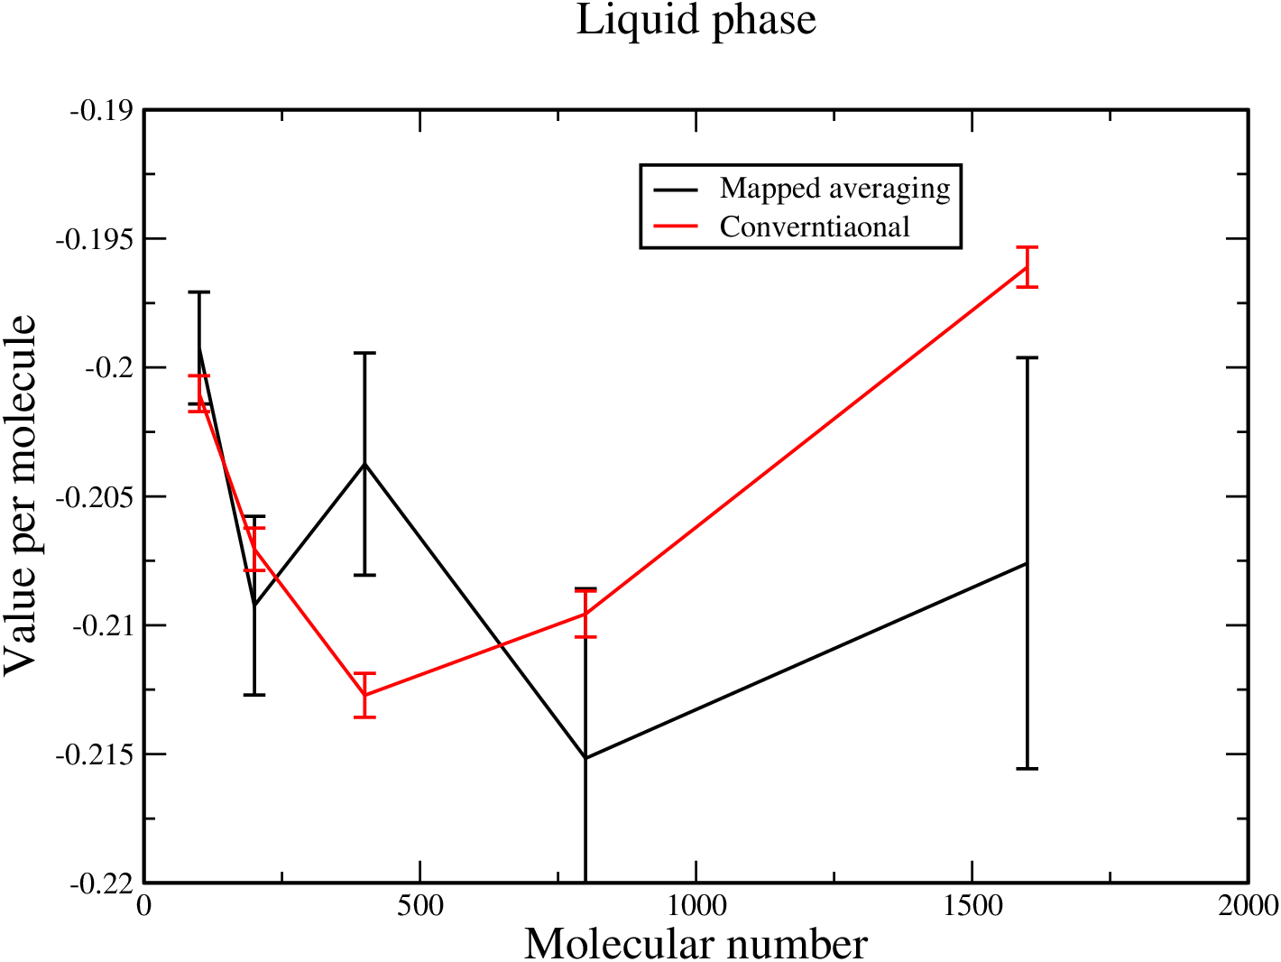
System Size effect
Notes:
N=100

Slide 20
Thanks!
PPT模板下载：www.1ppt.com/moban/ 行业PPT模板：www.1ppt.com/hangye/
节日PPT模板：www.1ppt.com/jieri/ PPT素材下载：www.1ppt.com/sucai/
PPT背景图片：www.1ppt.com/beijing/ PPT图表下载：www.1ppt.com/tubiao/
优秀PPT下载：www.1ppt.com/xiazai/ PPT教程： www.1ppt.com/powerpoint/
Word教程： www.1ppt.com/word/ Excel教程：www.1ppt.com/excel/
资料下载：www.1ppt.com/ziliao/ PPT课件下载：www.1ppt.com/kejian/
范文下载：www.1ppt.com/fanwen/ 试卷下载：www.1ppt.com/shiti/
教案下载：www.1ppt.com/jiaoan/

